Slide 1
Azure Key Vaults
Azure Key Vault is a cloud service that helps you securely store and manage sensitive information like secrets, keys, and certificates.
99% every projects works with key vaults

Slide 2
Explaination
Azure key Vaults is like password hider, we can access data from blob storage (initial layer) protected by key Vaults without seeing Azure Blob Storage password to access data
We took blob storage just for practice purpose.
Data can come from any source
Azure key Vault is like password hider, we can use service without knowing its secrets and passwords

Slide 3
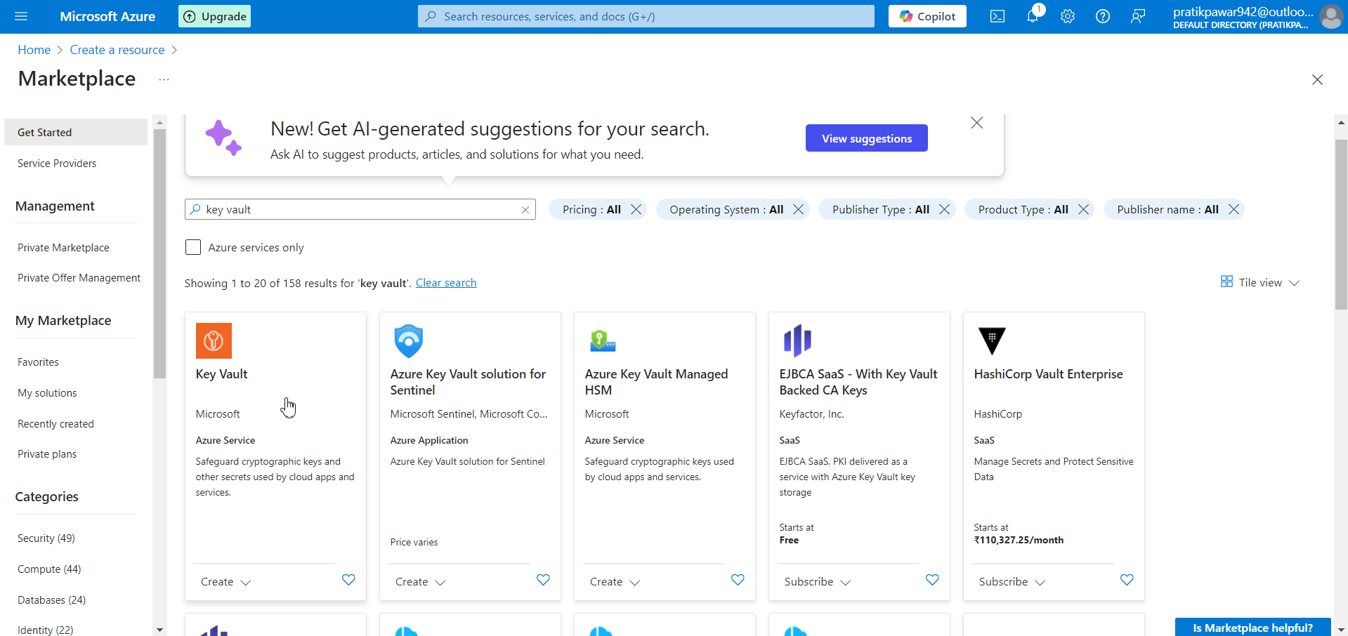
Go to Marketplace > Key Vaults

Slide 4
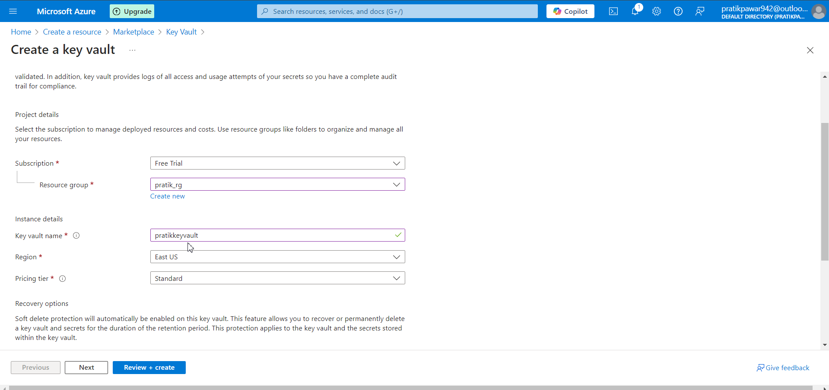
Write Resource Group and Key Vault name

Slide 5
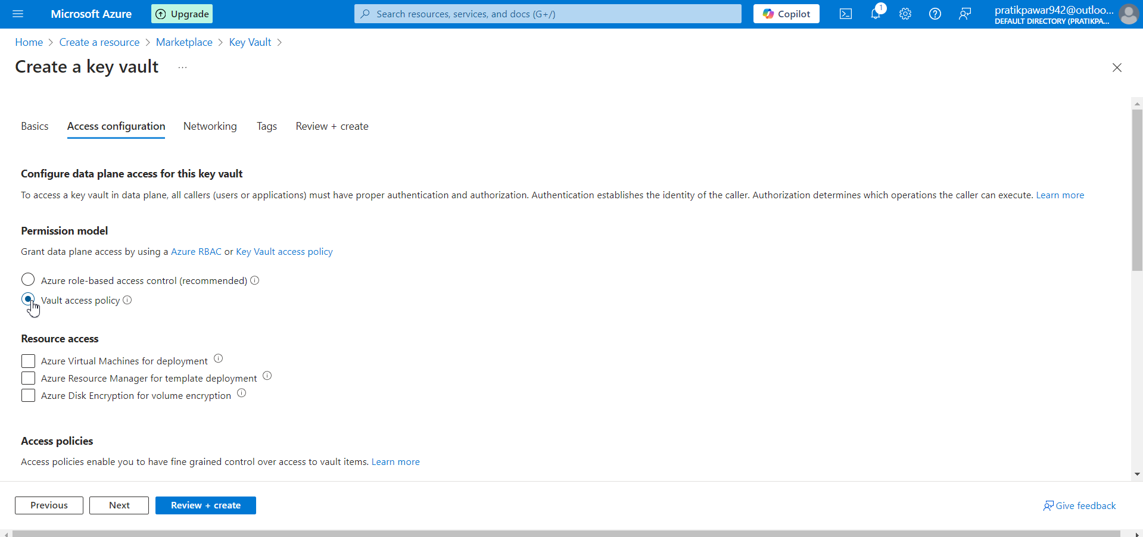
Choose the Permission Model according to Requirement

Slide 6
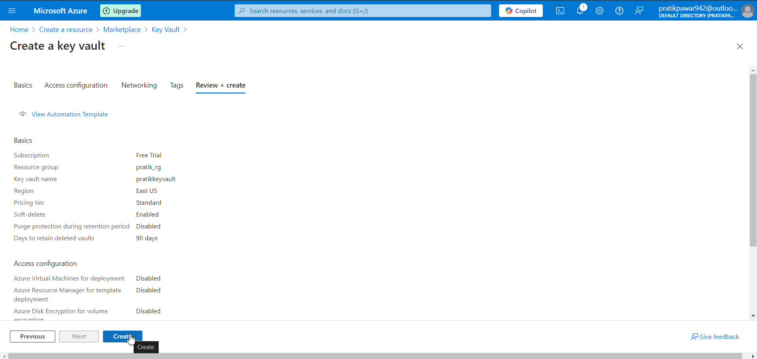
Create

Slide 7
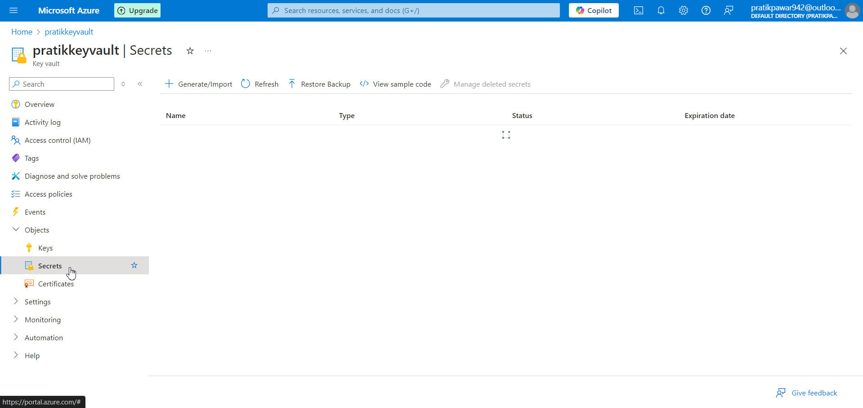
Go to key vaults > Objects > Secrets

Slide 8
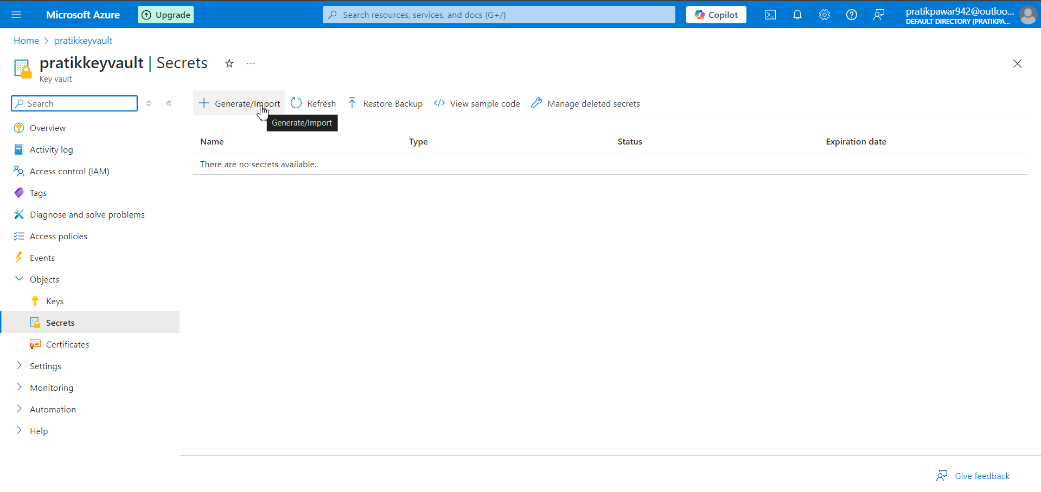
Generate/Import

Slide 9
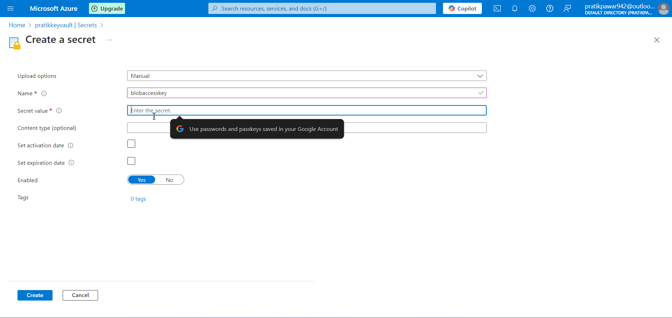
Give name of secret and Secret Value is password. Go to Blob > Access Keys and paste key in Secret Value

Slide 10
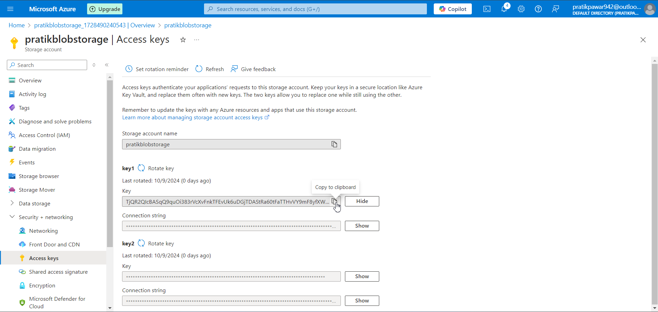
Copy Access key

Slide 11
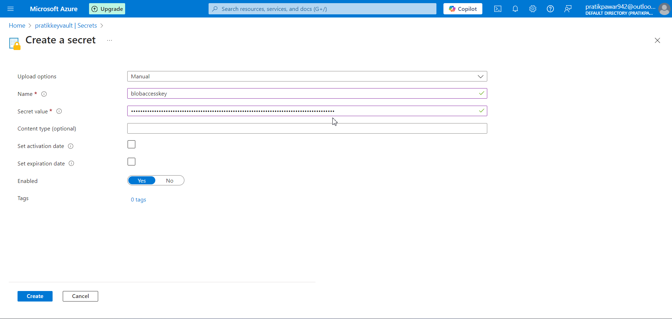
Paste here

Slide 12
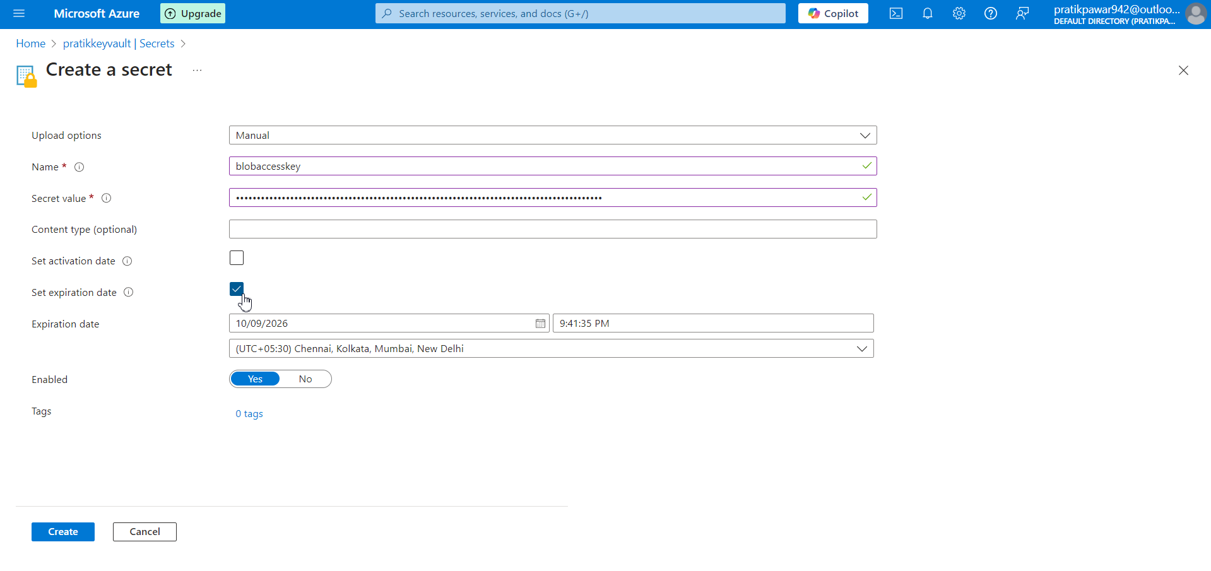
You can set Activation and Expiry Date of Secret > then Create

Slide 13
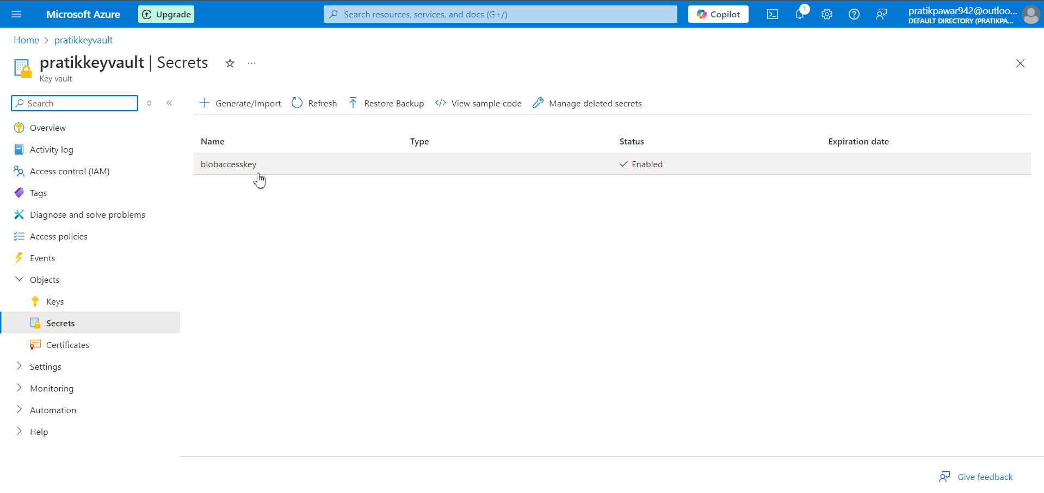
We have created Secret and only you can access the key and the people you gave permission to use it

Slide 14
In Databricks
In order to use secrets from Key Vaults Safely Databricks also have term ‘Scope’
Create new scope and connect key vault to scope will safely use passwords on both side without disclosure of Secrets
Scope is also like a protecting Vault

Slide 15
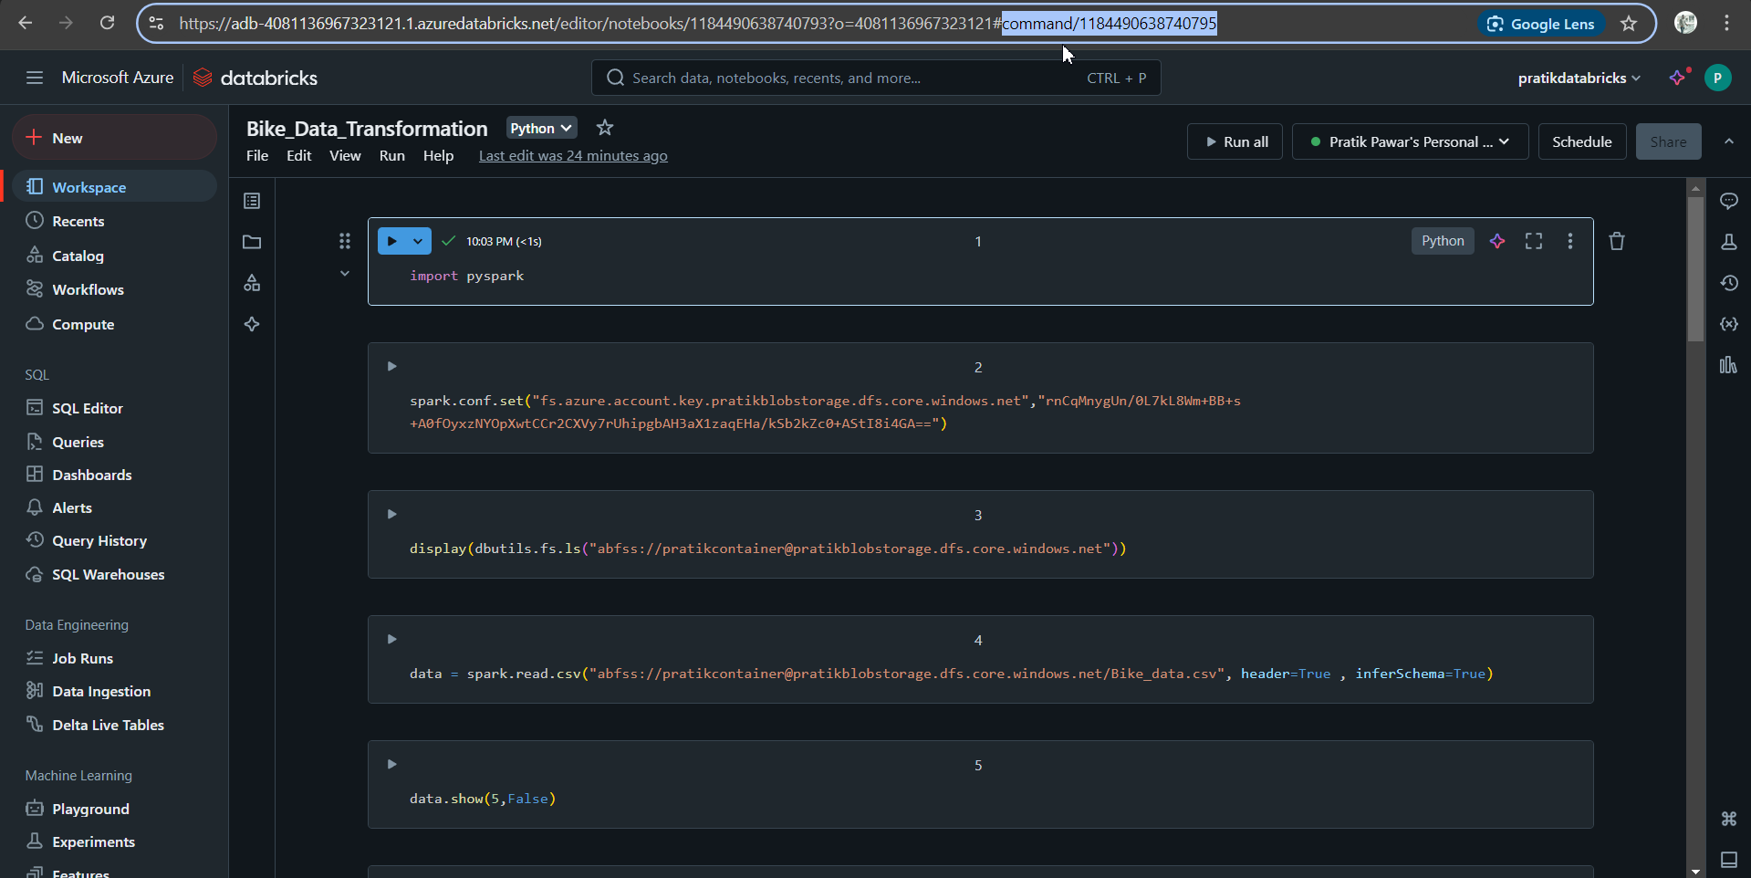
In order to create scope , it is not in option, we have type ‘secrets/createScope’ after # in main Databricks url to create scope(This is done so no one will access it easily)

Slide 16
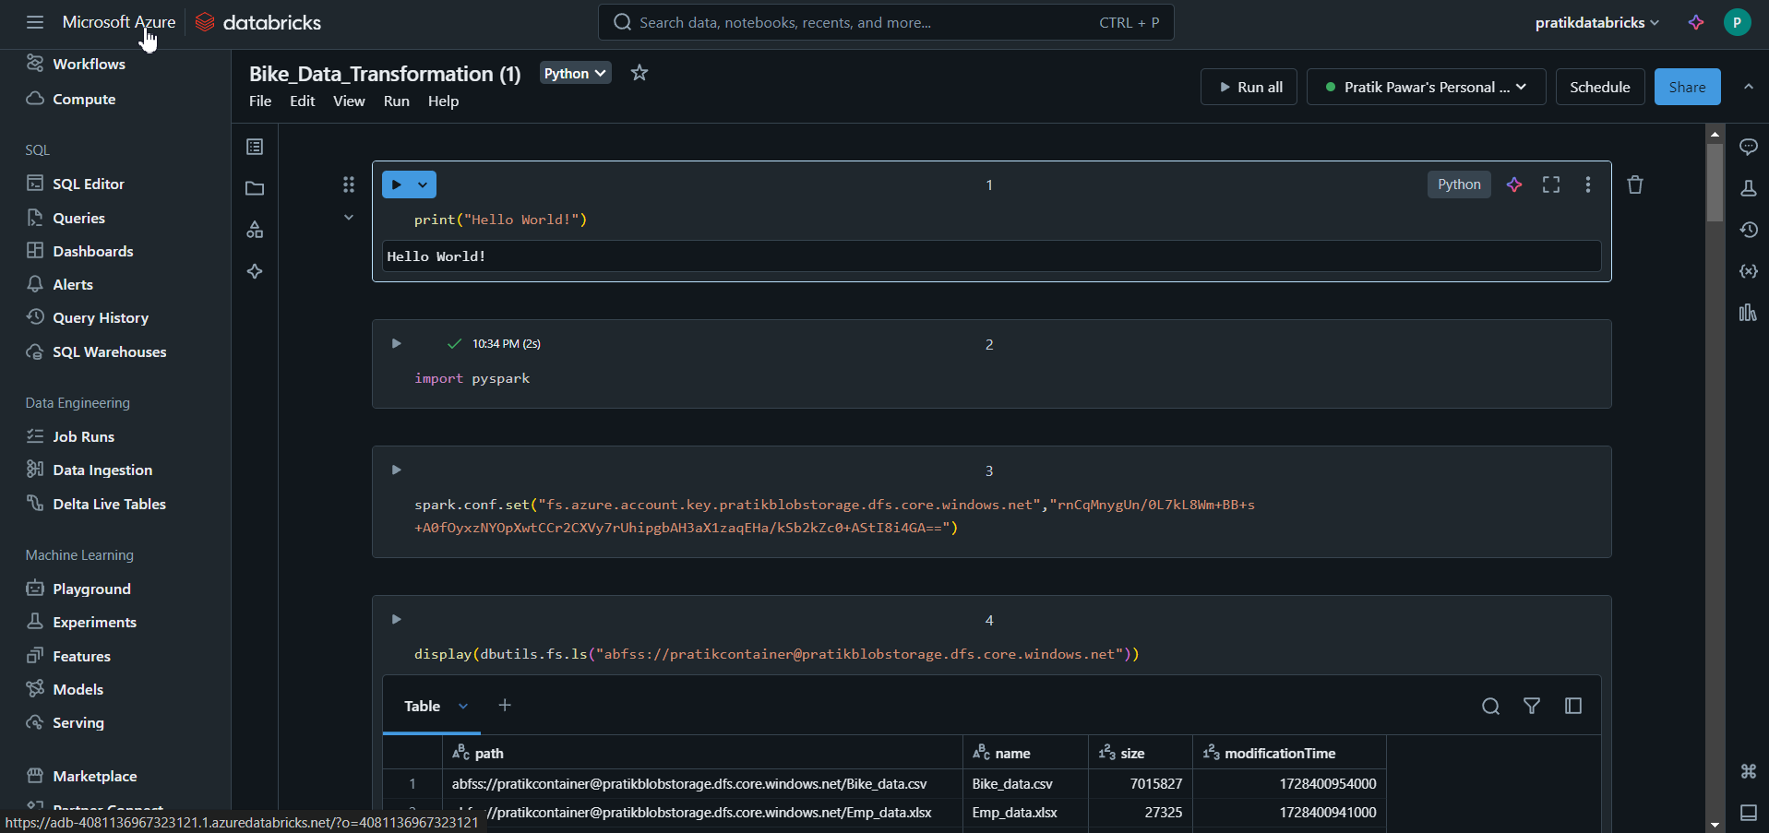
To create Scope Go to main page by clicking MS Azure

Slide 17
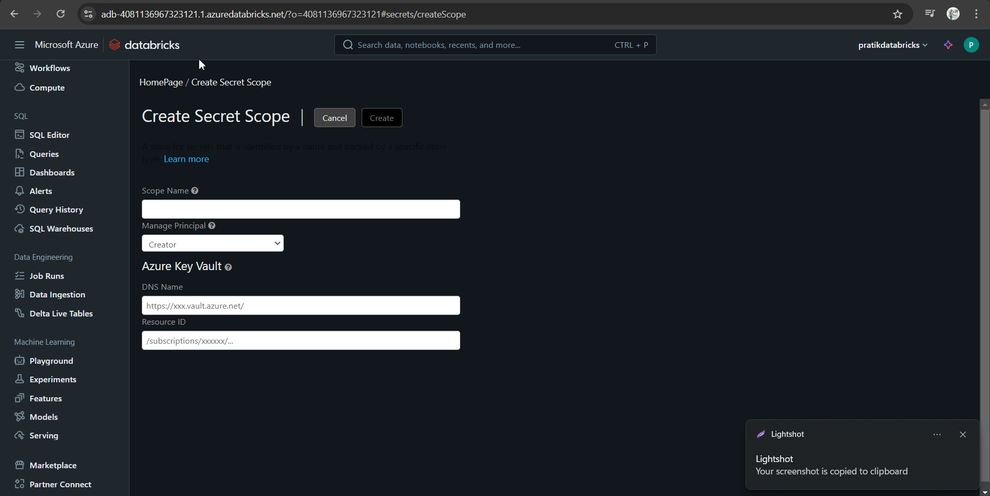
After the url type #secrets/createScope and enter

Slide 18
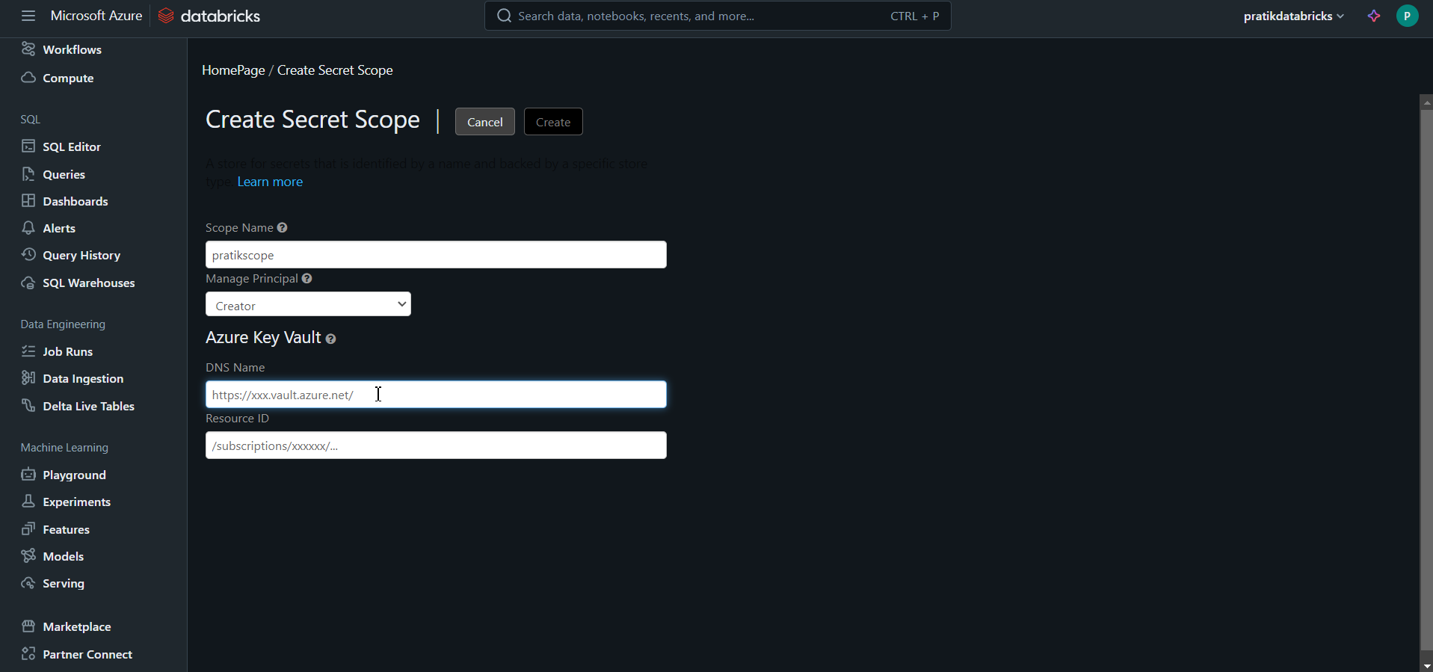
Give Scope Name and DNS Name from key vault

Slide 19
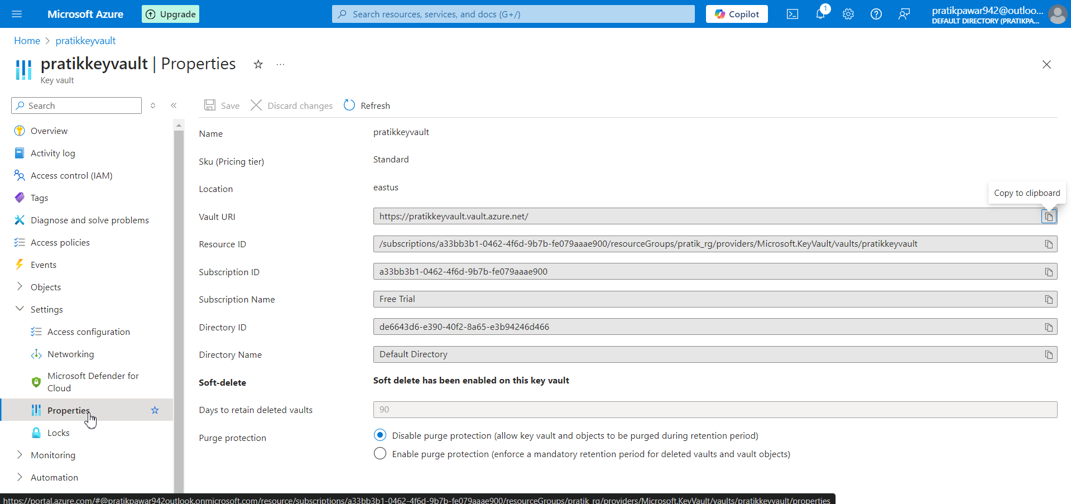
Go to key Vault > Settings > Properties

Slide 20
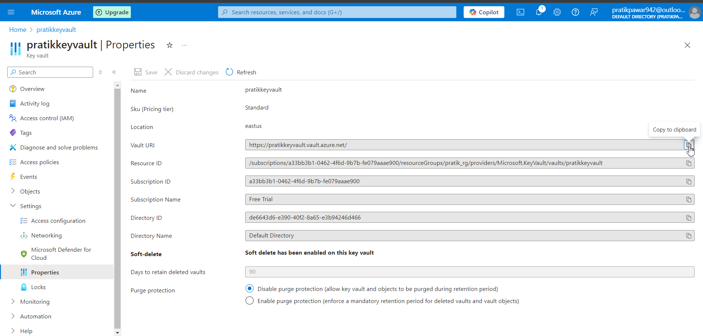
Copy Vault Uri and Resource ID and paste it in Scope page

Slide 21
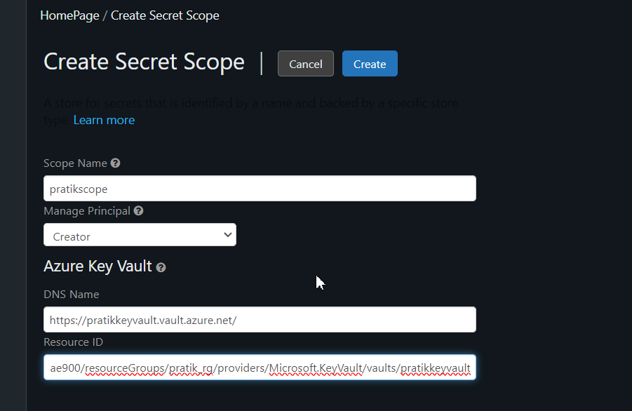
Info is filled > Create

Slide 22
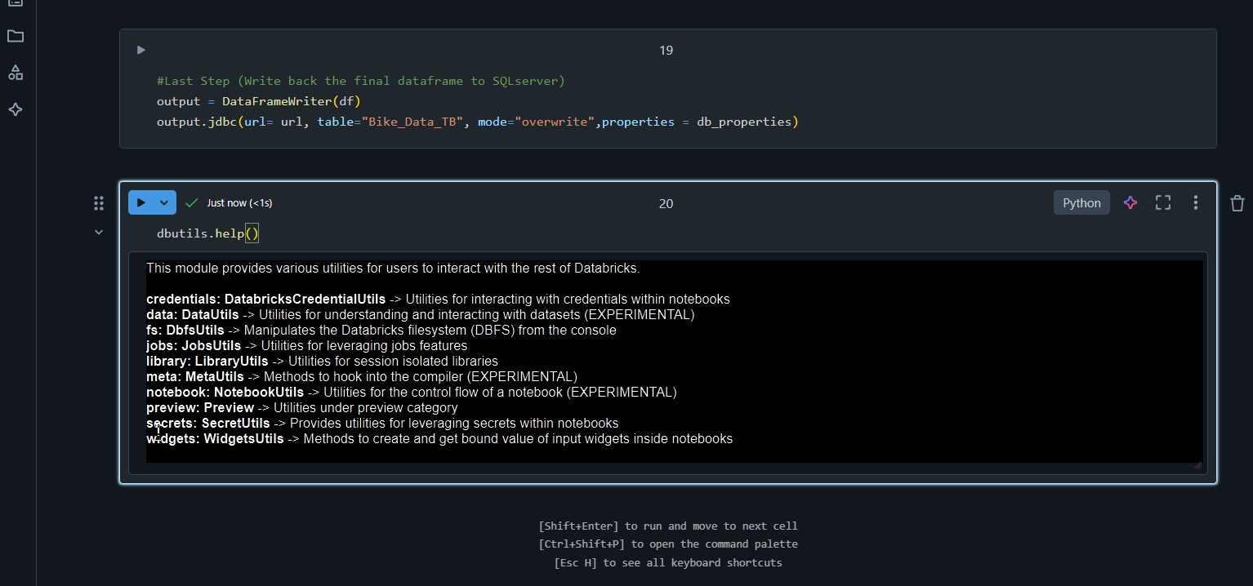
Now type dbutils.help() [dbutils is a set of utility functions provided by Databricks to help you interact with your Databricks environment more easily. Think of it as a toolbox for performing common tasks when working in Databricks notebooks, such as managing files, running commands, and working with secrets.]

Slide 23
Dbutils.help() show functions which can be perform by dbutils. Now use secrets function by typing dbutils.secrets.help() for further functions

Slide 24
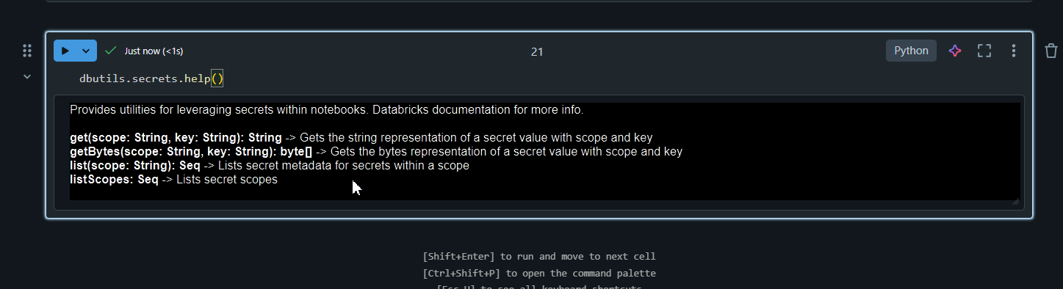
Now we can see scope list by dbutils.secrets.listScopes

Slide 25
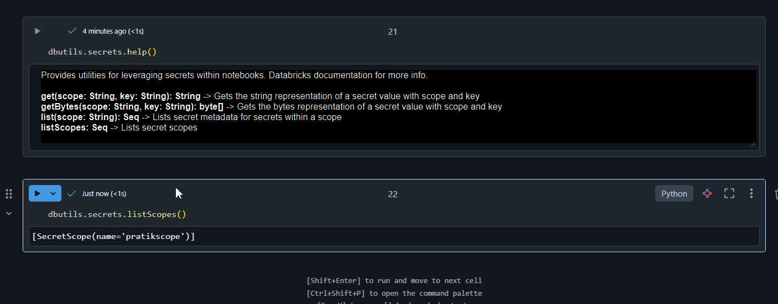
Here are the scope list

Slide 26
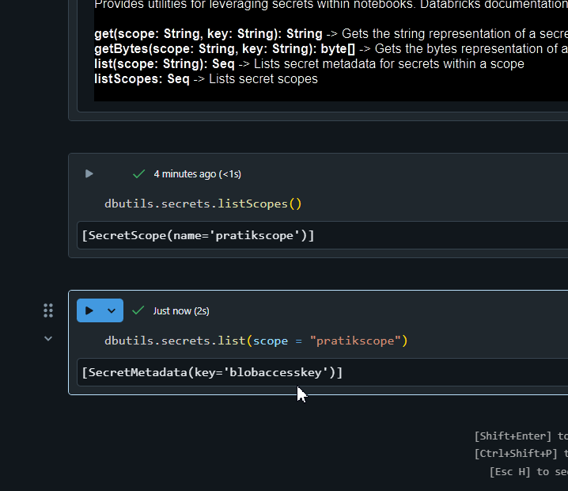
Now to get access key we need to use dbutils.secrets.list(scope = “pratikscope”. This will list the key so we can connect to blob storage

Slide 27
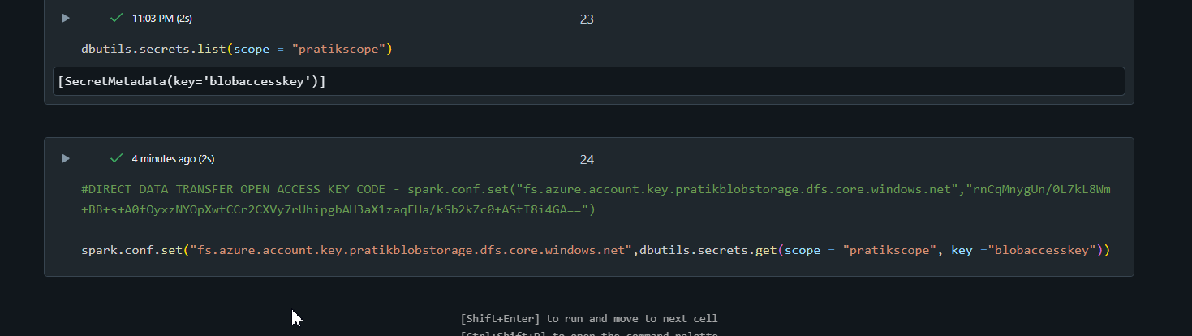
Now we have access the azure blob storage

Slide 28
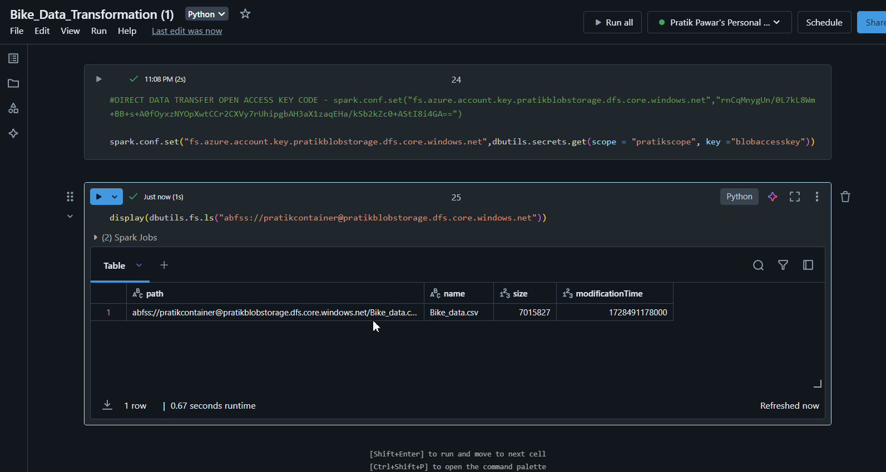
Now just use the path of Raw Data to extract file in Databricks

